Slide 1
Design and Analysis Of Algorithms
Unit-I

Slide 2
The origin of algorithms!
Algos means “pain” in Greek. Algor in Latin means “to be cold”. – neither is the root for the word “algorithm”!.
Algorithm stems from al-Khwarizmi, the name of the 19th-century Arab scholar who stressed the importance of methodical procedures for solving problems.
The algorithm makes us to break anything into small steps, for easy and effective understanding of the complex things.

Slide 3
Benefits of using Algorithms
There are numerous benefits of using algorithms in both our personal and professional lives,
You can transform any complicated thing into an algorithm, which will help you in the decision-making process.
Instead of creating a to-do list, you can write an algorithm to prioritize your daily tasks.
Based on your preferences and historical data, you can write an algorithm to get recommendations on what genre films to watch.
You can write an algorithm to foresee the best available time for you to go on a vacation.

Slide 4
CONTENTS
Introduction
Algorithm
Pseudo code
Performance Analysis
Asymptotic Notations

Slide 5
Introduction
WHATIS AN ALGORITHM?
Definition: An algorithm is a finite set of instructions that, if followed, accomplishes a particular task. In addition, all algorithms should satisfy the following criteria. properties
Input. Zero or more quantities are externally supplied.
Output. At least one quantity is produced.
Definiteness. Each instruction is clear and unambiguous.
Finiteness. If we trace out the instructions of an algorithm, then for all cases, the algorithm terminates after a finite number of steps.
Effectiveness. Every instruction must very basic so that it can be carried out, in principle, by a person using only pencil & paper.

Slide 6

Areas of study of Algorithm:
How to device or design an algorithm– It includes the study of various design techniques and helps in writing algorithms using the existing design techniques like divide and conquer.
How to validate an algorithm– After the algorithm is written it is necessary to check the correctness of the algorithm i.e. for each input correct output is produced, known as algorithm validation. The second phase is writing a program known as program proving or program verification.
How to analysis an algorithm– It is known as analysis of algorithms or performance analysis, refers to the task of calculating time and space complexity of the algorithm.
How to test a program – It consists of two phases .
Debugging is detection and correction of errors.
Profiling or performance measurement is the actual amount of time required by the program to compute the result.

Slide 7
Pseudo-Code for writing Algorithms

Slide 8
Algorithm Specification:
Algorithm can be described in three ways.
Natural language like English:
Graphic representation called flowchart: This method will work well when the algorithm is small& simple.
Pseudo-code Method: In this method, we should typically describe algorithms as program, which resembles language like Pascal & algol.

Slide 9
Pseudo-Code for writing Algorithms:
Comments begin with // and continue until the end of line.
Blocks are indicated with matching braces {and}.
An identifier begins with a letter. The data types of variables are not explicitly declared.
Compound data types can be formed with records. Here is an example,
Node. Record
{
data type – 1 data-1; .
data type – n data – n; node * link;
}
Here link is a pointer to the record type node. Individual data items of a record can be accessed with and period.
Assignment of values to variables is done using the assignment statement := ;

Slide 10
6. There are two Boolean values TRUE and FALSE.
Logical Operators AND, OR, NOT
Relational Operators <, <=,>,>=, =, !=
7. The following looping statements are employed.
While Loop:
While < condition >do
{ <statement 1>
<statement n>
}
For Loop:
For variable: = value-1 to value-2 step step do
{ <statement 1>
<statement n>
}

Slide 11
repeat-until:
repeat{
<statement 1>
<statement n>
}until<condition>

Slide 12
8. A conditional statement has the following forms.
If (condition) then <statement>
If (condition) then <statement1> else <<statement2>
Here(condition)is a Boolean expression and (statement),(statement1) and (statement2) are arbitrary statements(simple or compound).
Case statement:
case
{
:(condition 1):(statement1)
.
:(condition n): (statement n)
:else: (statement n+1)
}
9. Input and output are done using the instructions read and write. No format is used to specify the size of input or output quantities.
10. There is only one type of procedure: Algorithm. An algorithm consists of a heading and a body. The heading takes the form
Algorithm Name((parameter list))
The body has one or more (simple or compound)statements enclosed within braces{and }

Slide 13
Example:
Algorithm Max(A,n)
// A is an array of size n
{
Result := A[1];
for i:= 2 to n do
if A[i] > Result then Result :=A[i];
return Result;
}
In this algorithm (named Max), A & n are procedure parameters. Result & I are Local variables.

Slide 14
Performance Analysis

Slide 15
Performance evaluation can be divided into two major phases.
Performance Analysis (machine independent)
Space complexity: The space complexity of an algorithm is the amount of memory it needs to run for completion.
Time complexity: The time complexity of an algorithm is the amount of computer time it needs to run to completion.
2. Performance Measurement (machine dependent).

Slide 16
Space Complexity:
The Space Complexity of any algorithm P is given by S(P)=C+SP(I),C is constant.
1..Fixed Space Requirements (C) Independent of the characteristics of the inputs and outputs
– It includes instruction space (program)
– space for simple variables, fixed-size structured variable
( Component/Compound variables), constants etc.
2. Variable Space Requirements (SP(I)) depend on the instance characteristic I
– Space needed by component variable whose size is dependent on the particular problem instance
-Space needed by reference variable.
– recursive stack space : formal parameters, local variables, return address

Slide 17
Examples:
Example1 : Simple arithmetic function
Algorithm abc( a, b, c)
{
return a + b + b * c + (a + b - c) / (a + b) + 4.00;
}
Sabc(I)=0 Hence S(P)=Constant

Slide 18
Example 2: Iterative function for sum a list of numbers
Algorithm Sum( A[ ], n)
{
sum = 0;
for i = 0 to n do
sum += A [i];
return sum;
}
In the above example A[] is dependent on n. Hence SP(I)=n. The remaining variables are i, n, sum each requires one location
Hence S(P)=3+n
S(P)>=n+3

Slide 19
Example 3: Recursive function for sum a list of numbers
Algorithm rsum( A[ ], n)
{
If (n<=0) then
return 0.0
else
return rsum(A, n-1) + A[n];
}
In the above example the recursion stack space includes space for formal parameters local variables and return address. Each call to rsum requires 3 locations i.e for A[ ], n and return address .As the length of recursion is n+1.
S(P)>=3(n+1)

Slide 20
Time Complexity
T(P)=C+TP(I)
It is combination of-Compile time (C)
independent of instance (input and output) characteristics( size and number)
-run (execution) time TP
-dependent of instance characteristics.
Time complexity is calculated in terms of program step as it is difficult to know the complexities of individual operations.

Slide 21
A program step is a syntactically or semantically meaningful program segment whose execution time is independent of the instance characteristics.
Program steps are considered for different statements as :
for comment zero steps .
assignment statement is considered as one step.
Iterative statements such as “for, while and until-repeat” statements, we consider the step counts based on the expression .

Slide 22
Methods to compute the step count:
1) Introduce variable count into programs
2) Tabular method
Determine the total number of steps contributed by each statement step per execution * frequency
add up the contribution of all statements

Slide 23
Example 1. with count statements
Algorithm sum( list[ ], n)
{ // finding sum of n array element
tempsum := 0; count++; /* for assignment */
for i := 1 to n do
{
count++; /*for the for loop */
tempsum := tempsum + list[i]; count++; /* for assignment */
}
count++; /* last execution of for */
count++; return tempsum; /* for return */
}
=1(Assignment statement) + (n+1)(for loop) + n(statement in for loop) + 1(return statement)= n+3
Hence T(n)=2n+3

Slide 24
Example 2: Recursive sum
Algorithm rsum( list[ ], n)
{
count++; /*for if conditional */
if (n<=0)
{
count++; /* for return */
return 0.0
}
else {count++; return rsum(list, n-1) + list[n];}
/*for return and rsum invocation*/
}
Trsum(n)= 2 if n=0
Trsum(n)=2+Trsum(n-1) otherwise
Trsum(n)>=2n+2
T(n)=2n+2

Slide 25
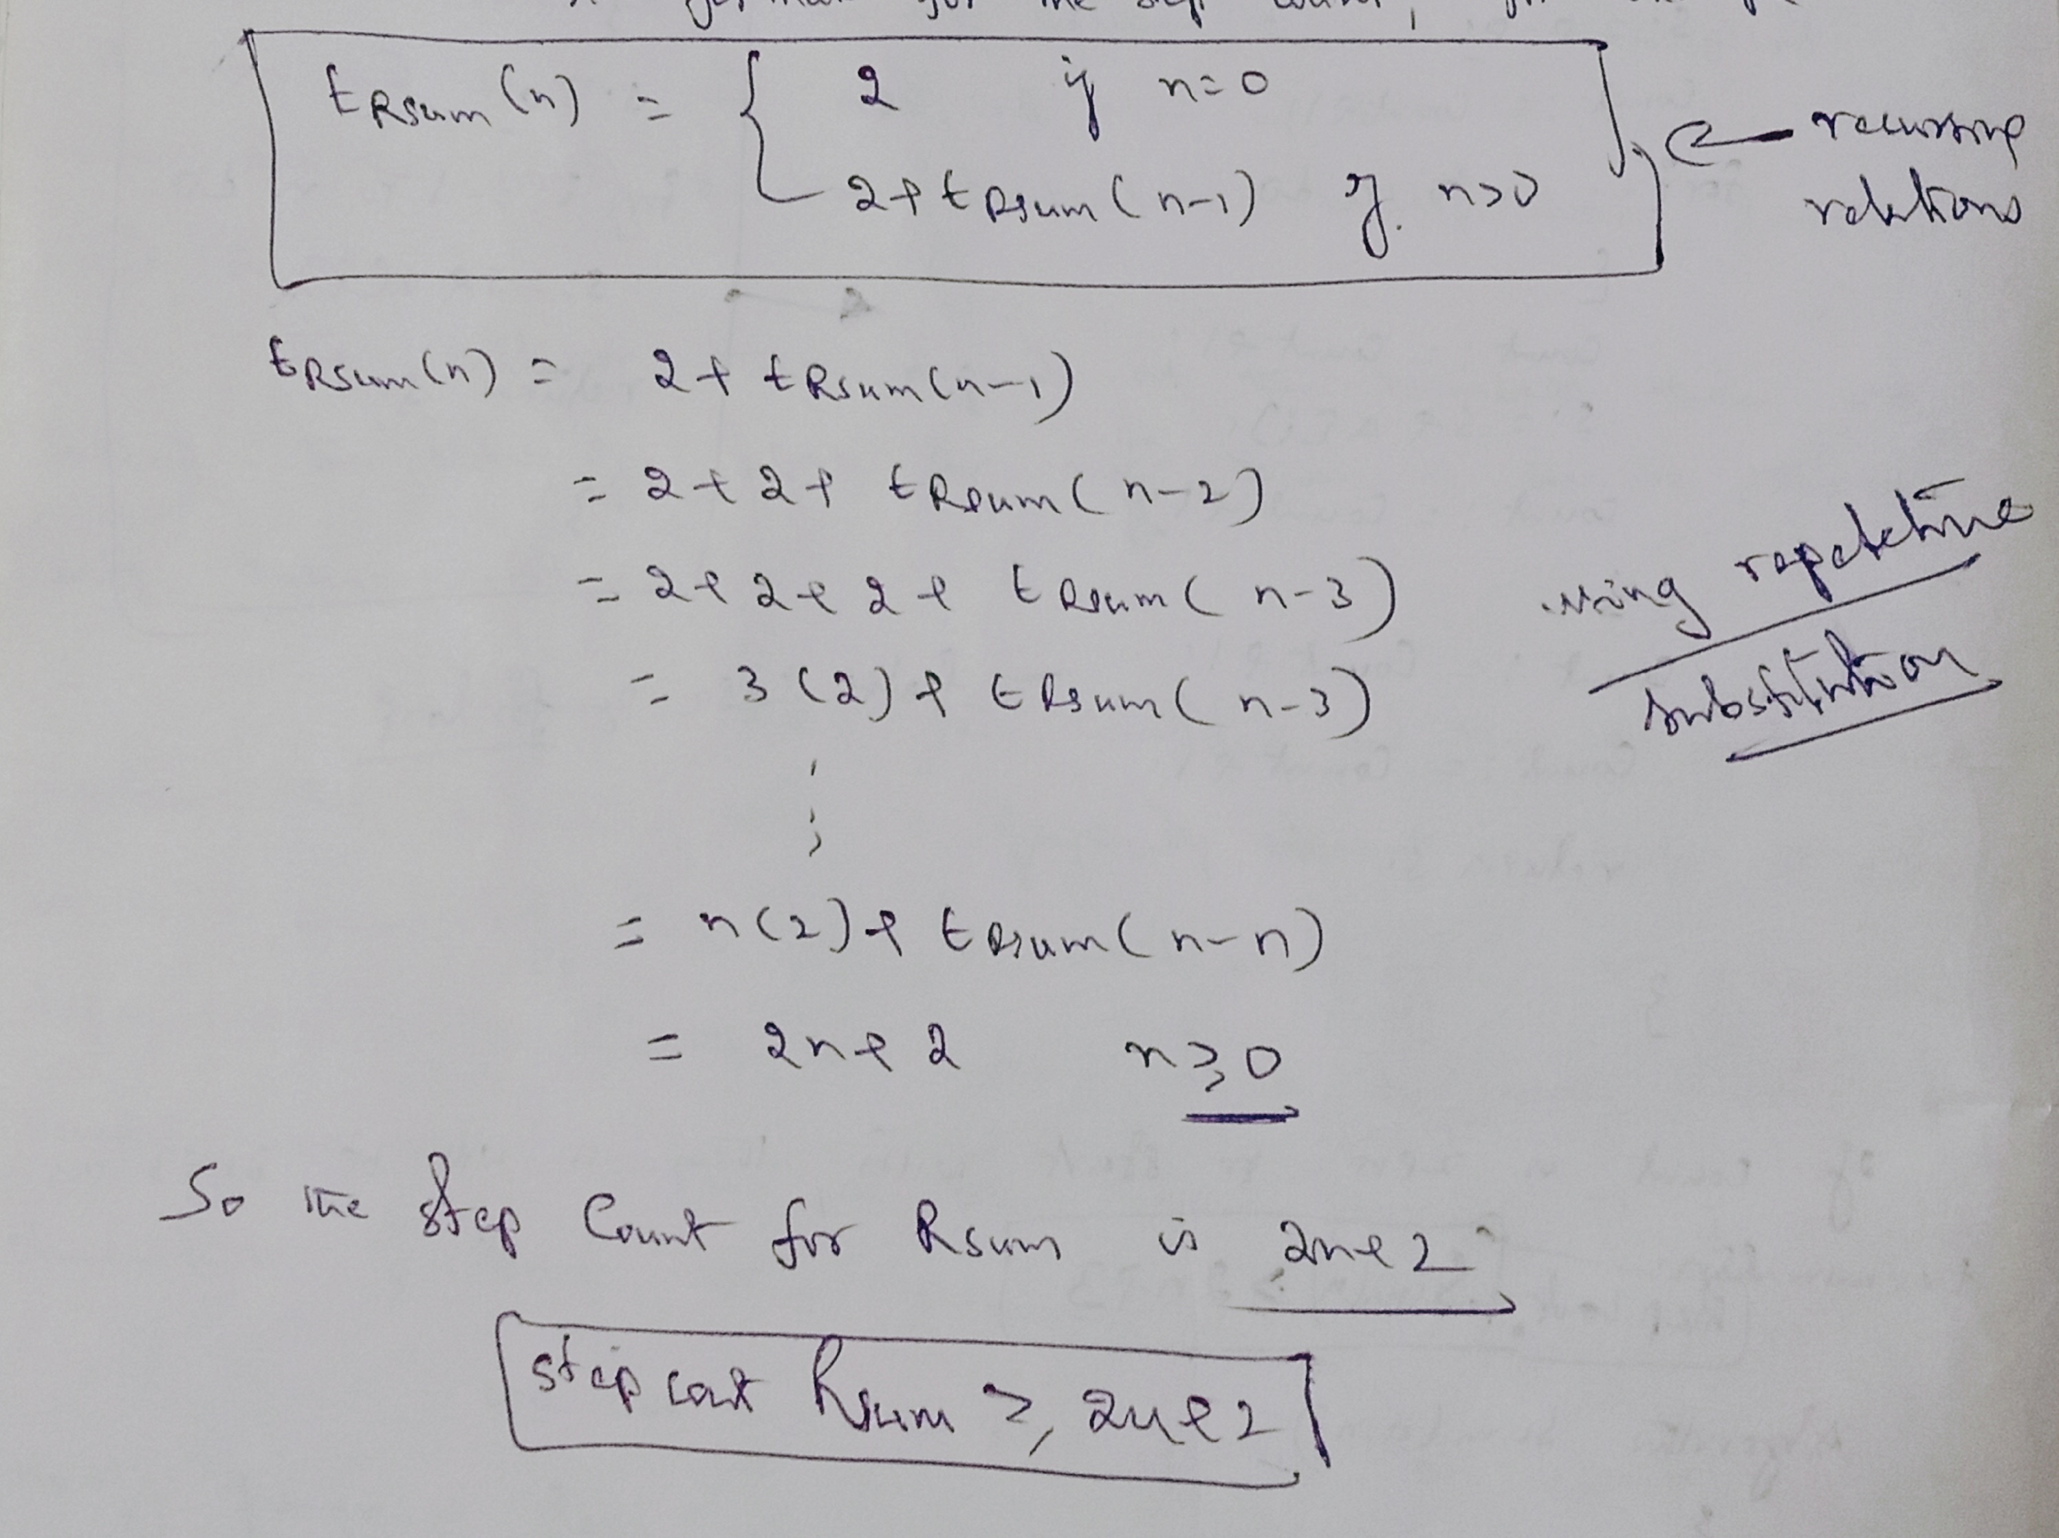

Slide 26
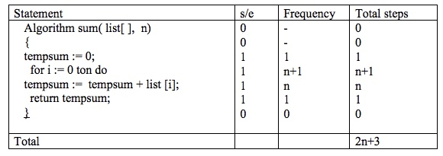
II Tabular method.
Complexity is determined by using a table which includes steps per execution(s/e) i.e. amount by which count changes as a result of execution of the statement.
Frequency – number of times a statement is executed.

Slide 27
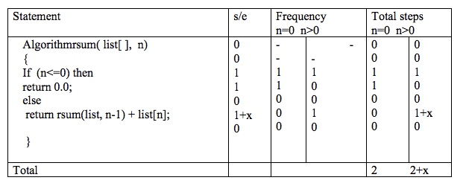
Example 2: Recursive sum

Slide 28
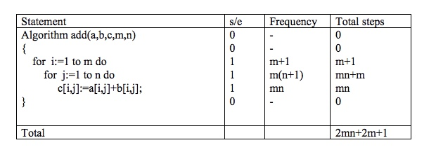
Example 3:

Slide 29
Complexity of Algorithms
The complexity of an algorithm M is the function f(n) which gives the running time and/or storage space requirement of the algorithm in terms of the size ‘n’ of the input data. Mostly, the storage space required by an algorithm is simply a multiple of the data size ‘n’.
Complexity shall refer to the running time of the algorithm. The function f(n), gives the running time of an algorithm, depends not only on the size ‘n’ of the input data but also on the particular data.
The complexity function f(n) for certain cases are:
1. Best Case : The minimum possible value of f(n) is called the best-case.
2. Average Case : The average value of f(n).
3. Worst Case : The maximum value of f(n) for any key possible input.
The field of computer science, which studies efficiency of algorithms, is known as analysis of algorithms.

Slide 30
Asymptotic Notations

Slide 31
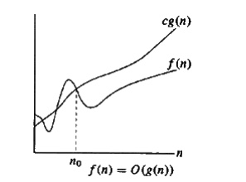
Big-Oh Notation (O)
The function f(n)=O(g(n)) (read as “f of n is big oh of g of n”) iff there exist two positive constants c and n0 such that f(n)≤C*g(n) for all n, n≥0
The value g(n)is the upper bound
Example:
3n+2=O(n) as
3n+2 ≤4n for all n≥2

Slide 32
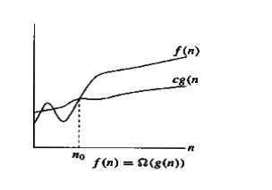
Omega Notation : Ω
The function f(n)=Ω (g(n)) (read as “f of n is Omega of g of n”) iff there exist two positive constants c and n0 such that f(n)≥C*g(n) for all n, n≥0
The value g(n) is the lower bound
Example:
3n+2=Ω (n) as
3n+2 ≥3n for all n≥1

Slide 33
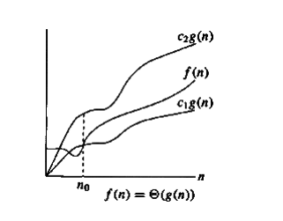
Theta Notation : θ
The function f(n)= θ (g(n)) (read as “f of n is theta of g of n”) iff there exist three positive constants c1, c2 and n0 such that C1*g(n) ≤f(n)≤C2*g(n) for all n, n≥0
Example:
3n+2=θ (n) as 3n+2 ≥3n for all n≥2
3n+2 ≤3n for all n≥2 Here c1=3 and c2=4 and n0=2

Slide 34

Little oh: o
The function f(n)=o(g(n)) (read as “f of n is little oh of g of n”)
iff $\lim_{n→∞}{ }$f(n)/g(n)=0 for all n, n≥0 n
Example: 3n+2=o($n^{2}$) as $\lim_{n→∞}{ }$ ((3n+2)/$n^{2}$)=0, n ≥0

Slide 35
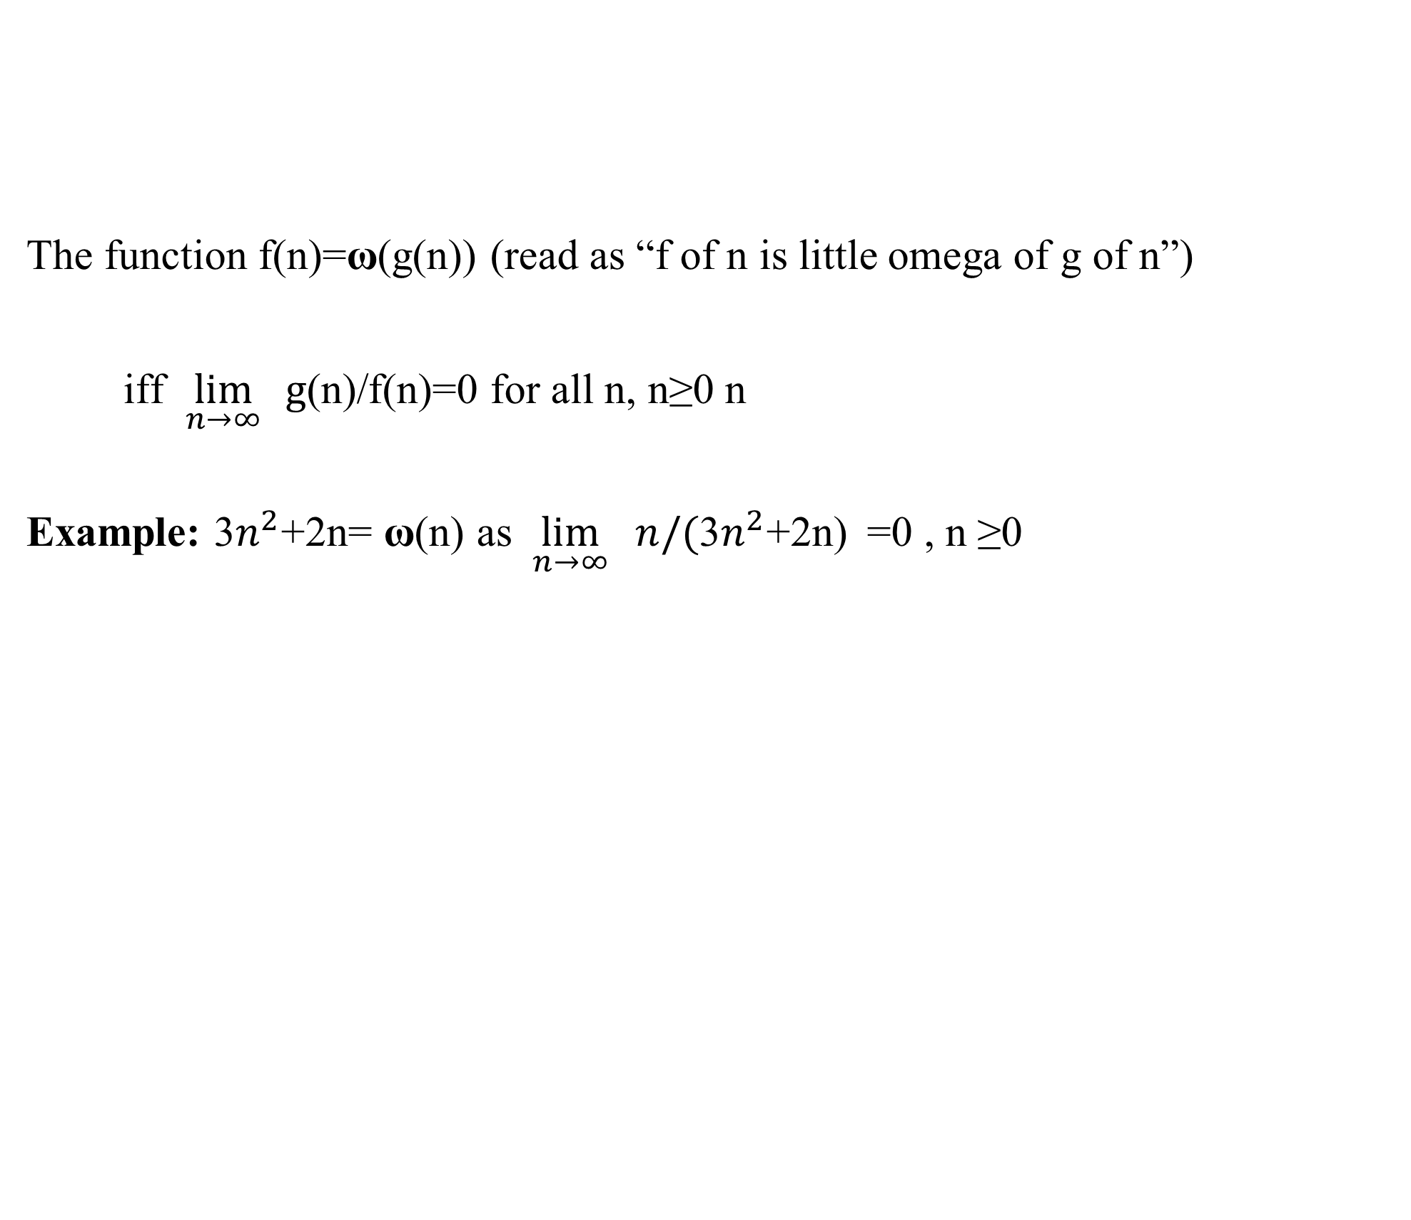
Little omega: ω
The function f(n)=ω(g(n)) (read as “f of n is little omega of g of n”)
iff $\lim_{n→∞}{ }g$(n)/f(n)=0 for all n, n≥0 n
Example: 3$n^{2}$+2n= ω(n) as $\lim_{n→∞}{ n/(\text{3}n^{2}\text{+}\text{2}\text{n}\text{)} }$=0 , n ≥0

